Slide 1
Data-Driven Tourism and Traffic Management in NYC
By: Alina Baby, Nithila Annadurai, Peter Alonzo
Team: thePANDAs
Tech Catalyst Program Capstone
Instructed by: Tarek Atwan
August 09, 2024
Notes:
Peter

Slide 2



Meet Our Team!
Peter Alonzo
Personal Lines Data Analytics
Alina Baby
Personal Lines ARE
Nithila Annadurai
Personal Lines Data Analytics
Notes:
All
Name, team, manager
ARE = Analytic Rating Engine

Slide 3

The Duality of NYC Tourism and Traffic Congestion
$74
$9.1
BILLION
but…
BILLION
Generated revenue for NYC tourism in 2023
Deficit from lost hours due to traffic congestion in 2023
How do we keep the world’s most-congested city a top tourist destination?
Notes:
Peter - To put $74 billion into perspective, that’s 2.5x the net worth of The Hartford ($29.83B as of June 2024)
Regular Motorists lost an average of 101 hours due to traffic (just over 4 days per person)

Slide 4



Project Goals
As a tourism company consultant, we strive to answer the following questions with data:
Which areas/boroughs have the highest traffic congestion?
Where should I go as a tourist for a specific type of landmark?
How can I find a trip that’s right for me based on my needs?
Notes:
Nithila

Slide 5
Raw Data Analysis
Dataset | Records kept | Records dropped | Total records
Yellow Taxi | 28.4M (98.7%) | 383.5K (1.3%) | 28.8M
Green Taxi | 506.3K (98.3%) | 8.9K (1.7%) | 515.3K
HVFHV | 96.7M (96.1%) | 4.0M (3.9%) | 100.7M
Landmarks | 656 (42.8%) | 876 (57.2%) | 1.5K
Taxi Zones | 263 (99.2%) | 2 (0.8%) | 265
Yellow/Green Taxi contain ride and transaction data for taxi trips from Sep 2023 to May 2024
HVFHV contains ride and transaction data from Uber/Lyft rides from Jan 2024 to May 2024
Landmarks includes a variety of popular NYC spots, their descriptions, and corresponding geospatial data
Taxi Zone Lookup holds location IDs mapped to taxi zones and boroughs
Notes:
Peter: High Volume For Hire Vehicles

Slide 6



Data-Related Assumptions and Outliers
Landmarks: | All Trips:
Dropped irrelevant landmarks Residential Trees Lamp Posts Dropped missing info Landmark Name Landmark Address | Invalid and unknown values Taxi: invalid year HVFHV: invalid driver pay Both: unknown drop-off locations Invalid fare amounts and trip distance/duration Metric 1: Cost/mile > $500/mi Metric 2: Cost/min > $1000/min
Goal: Ensure data quality before visualization
Notes:
Peter

Slide 7
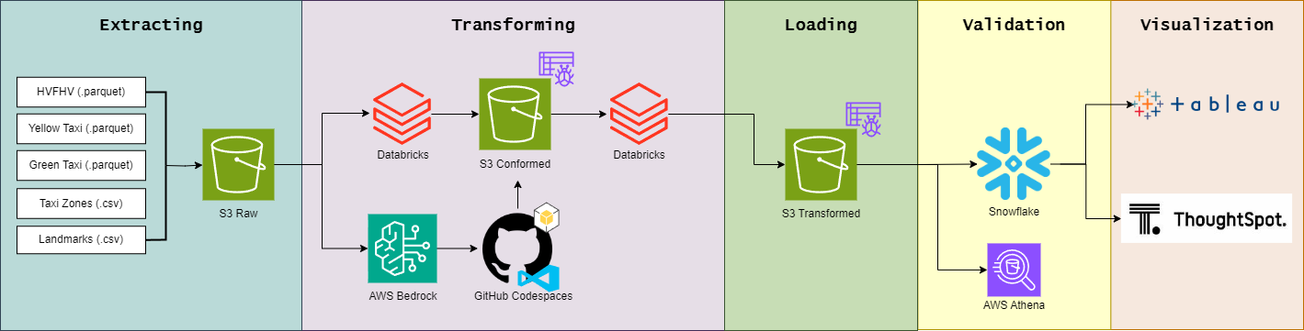
Solution Architecture Diagram
8/1: Project planning, data exploration, cleaning, and merging
8/2: Data loading and validation, defining use case, Amazon Bedrock connection, Snowflake table creation
8/5: Snowflake view creation, data visualization, integrating external data transformations
8/6: Finalizing visualizations and diagram, presentation creation
Notes:
Nithila & Alina & Peter

Slide 8



Challenges and Solutions
Challenge: Missing information for boroughs
Challenge: Amazon Bedrock quirks
Challenge: Outlier Tables in Databricks
Solution: Manually entering borough for 6 bridge records and removing landmarks that were missing key information
Solution: Experimenting with prompt to get standardized output and calling model in chunks
Solution: Partitioning data, splitting up uploads into multiple cells, and utilizing Snowflake instead for populating outlier data
Notes:
Alina, Nithila, Peter

Slide 9
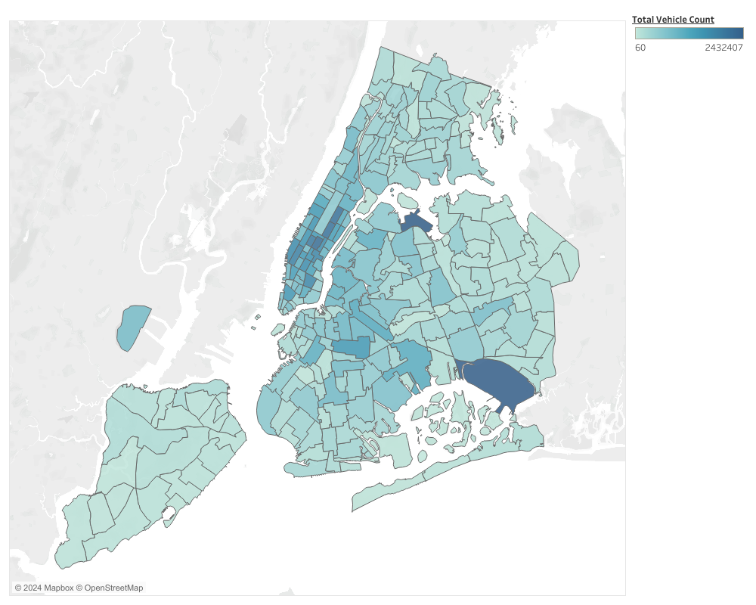
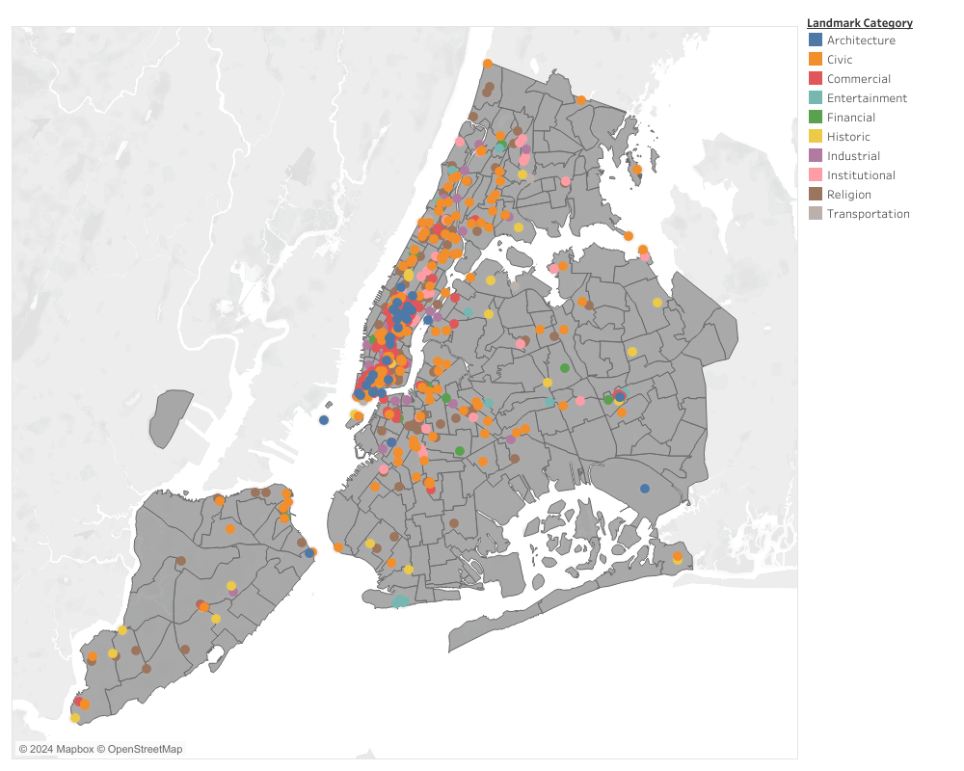
Which areas/boroughs have the highest traffic congestion?
Traffic Congestion
Landmark Density Map
Key Takeaways
Manhattan is by far the most congested area for traffic and landmark location
There is a positive, proportional correlation between traffic congestion and landmark density
From this, we found that tourists tend to visit Manhattan’s landmarks more than any other borough
Notes:
Nithila

Slide 10
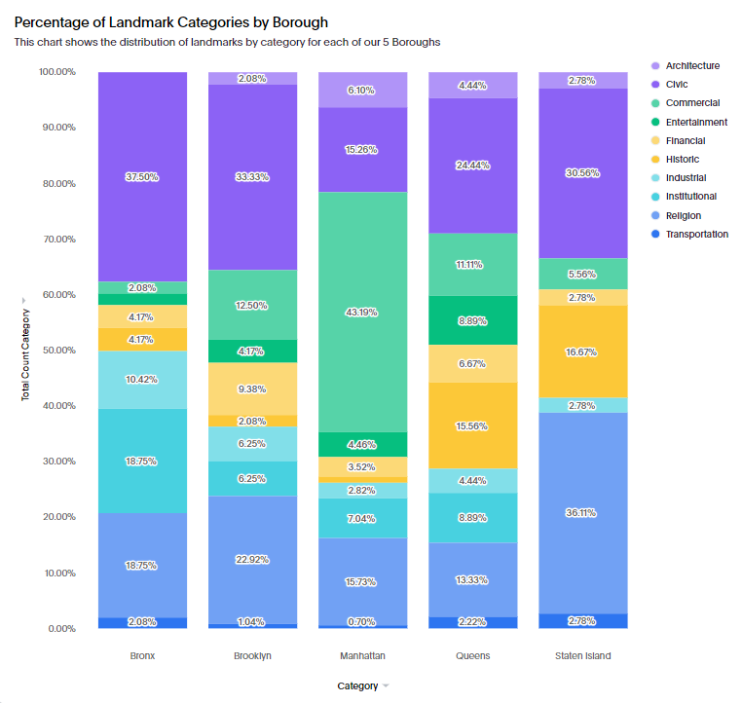
Where should I go as a tourist for a specific type of landmark?
Percent Leaders
Bronx: Civic, Industrial, Institutional
Brooklyn: Financial
Manhattan: Architecture, Commercial
Queens: Entertainment
Staten Island: Historic, Religion, Transportation
Key Takeaways
Queens and Brooklyn offer an even distribution of categories
Every borough is a leader in at least one landmark category
Tourists can choose areas with specific landmark categories or areas with a more even variety
Notes:
Peter

Slide 11
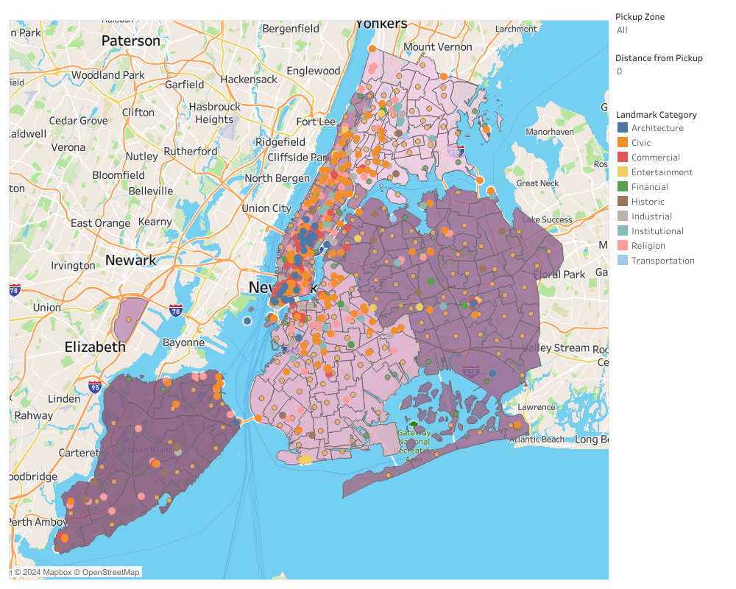
How can I find a trip that’s right for me based on my needs?
Key Takeaways
A tourist can use this dashboard to determine which landmarks are within a comfortable distance based on traveling needs and within a specific category based on preference
A tourist can decide to stay in an area with less traffic congestion but can still have a wide variety of landmarks to choose from
Future solution would include implementing travel cost filters and real-time traffic data
Notes:
Alina Transition to solution diagram by introducing customer friendly application

Slide 12
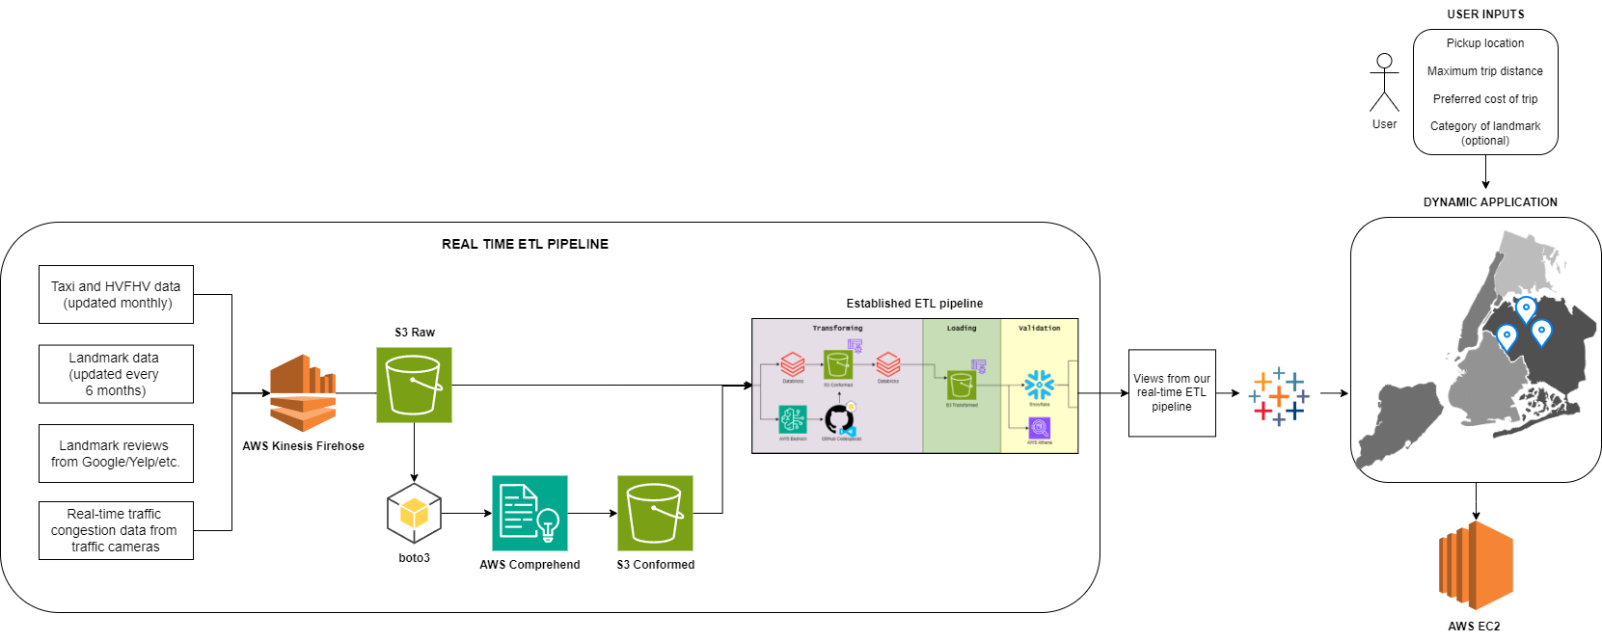
Future Course of Action
Oct 2024: Fully construct real-time ETL pipeline
Dec 2024: Integrate and automate real-time and established ETL pipelines
Jun 2025: Finalize requirements with stakeholders and begin application creation
Sep 2025: Application testing and marketing product
Notes:
Alina & Nithila

Slide 13

Thank you for your time! Any questions?
Check out our GitHub: github.com/alina-hartford/thePANDAsCapstone/

